Slide 1

Scaling Solar:
A World Bank Group solution to rapidly expand private investment in utility-scale solar PV

Slide 2
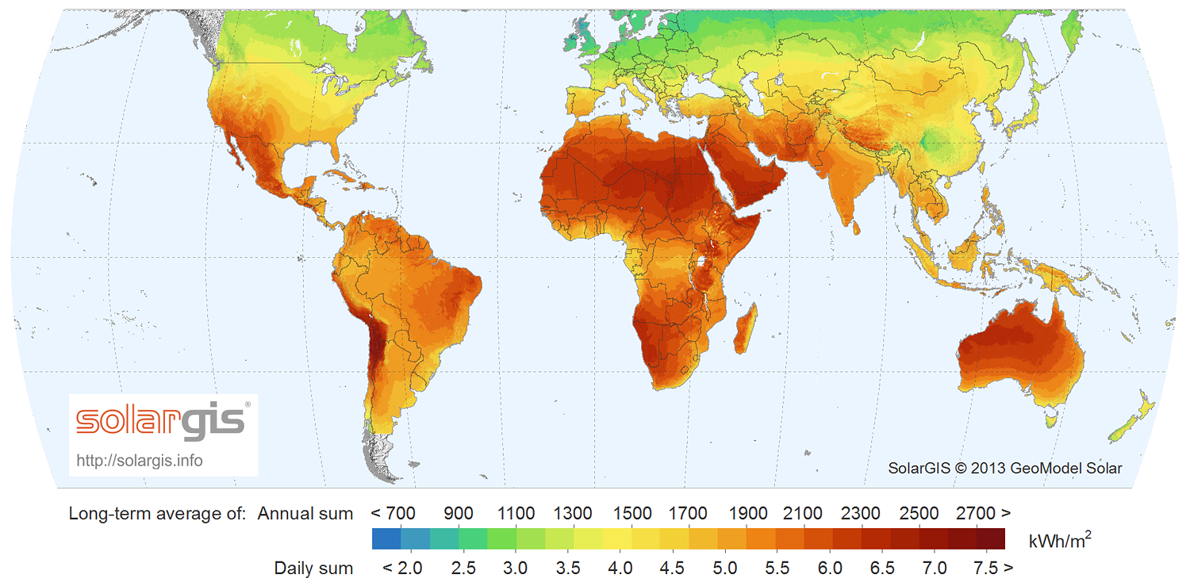
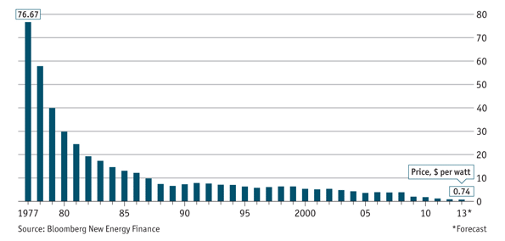
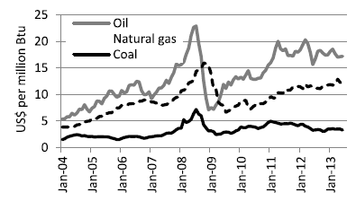
Solar power generation has reached a tipping point
The economics of utility-scale solar PV power have reached a tipping point…
…and many IFC markets benefit from some of the best irradiation levels on the planet
Price of crystalline silicon PV cells, $/W
Solar power can be built in 3-6 months vs. 3-10 years for thermal, hydro & geothermal…
….and many countries need to diversify away from a dependency on HFO and fossil fuels
Typical construction periods (months)
Evolution of oil, gas and coal prices since 2004

Slide 3
But investment in solar PV is slow…
Lack of market scale
Lack of competition
High transaction costs
High perceived risk and cost of capital
Limited institutional capacity

Slide 4
Scale, standardization & competition are needed
Case Study: Dramatic tariff reductions have been achieved in South Africa
Large, repeat allocation
Capacity build-up
Strong competition
Tariff decrease
Inclusive Framework
Proven bankable
Program expansion
High investor interest
Capacity allocated per round (MW)
Tariffs per round (ZAR/kWh)
Number of received bids and success rate (includes wind)
+1,900 MW of solar PV power
Tariff drop of -76% for PV projects over the 4 rounds
Surge in investor interest and increasing selectivity in bidders afforded

Slide 5

The WBG solution: A “One-Stop-Shop” offering
    Scaling Solar is a “one-stop-shop” for Governments to rapidly mobilize competitive privately funded grid connected solar projects within 2 years of engaging our team.
    Scaling Solar brings together several World Bank Group services under a single engagement:
  Advice to assess the right size and location for power plants in grid.
  Simple and rapid tendering to ensure strong competition from committed industry players.
  Standardized, balanced project documents to eliminate drafting and negotiation delays.
  Competitive financing and insurance attached to tender and available to all bidders.
  Risk management and credit enhancement products to lower financing costs and deliver lower tariffs.

Slide 6
What’s new about this?
The ‘One-Stop-Shop’ Approach
A focus on standardization
Likelihood of quick wins
Whole WBG in one packaged solution
A single mandate
Designed with both Government and Developers in mind
Fully developed documentation quickly tailored to local needs drives speed
Standardization across countries creates a single, ‘virtual’, large scale market
Coordinated delivery to address both public and private sector constraints
The WBG has the expertise to make it work
Lessons embedded from successful and unsuccessful precedents
Standardization delivers speed, efficiency, programmatic scale and competition to reduce tariffs and entice top tier developers to participate
Coordinated, collaborative and rapid delivery

Slide 7

























Developers that have participated in Scaling Solar tenders

Slide 8
Scaling Solar tender results in Zambia
Projects were developed and tender was prepared and executed to conclusion in 9 months
 | West lunga Site | Mosi-oa Tunya Site
Neoen / First Solar | 6.0150 | 6.1350
ENEL Green Power | 7.7989 | 7.8390
Access / EREN Zambia 1 | 8.2879 | 8.9509
MULILO Zambia PV1 Consortium | 8.4000 | 8.4000
EDF Energies Nouvelles | 10.0400 | 9.9850
SEP / AVIC Intl | 10.6000 | 10.6000
6.0c/kWh non-indexed is equivalent to an average in current dollars over contract life of 4.7c/kWh

Slide 9
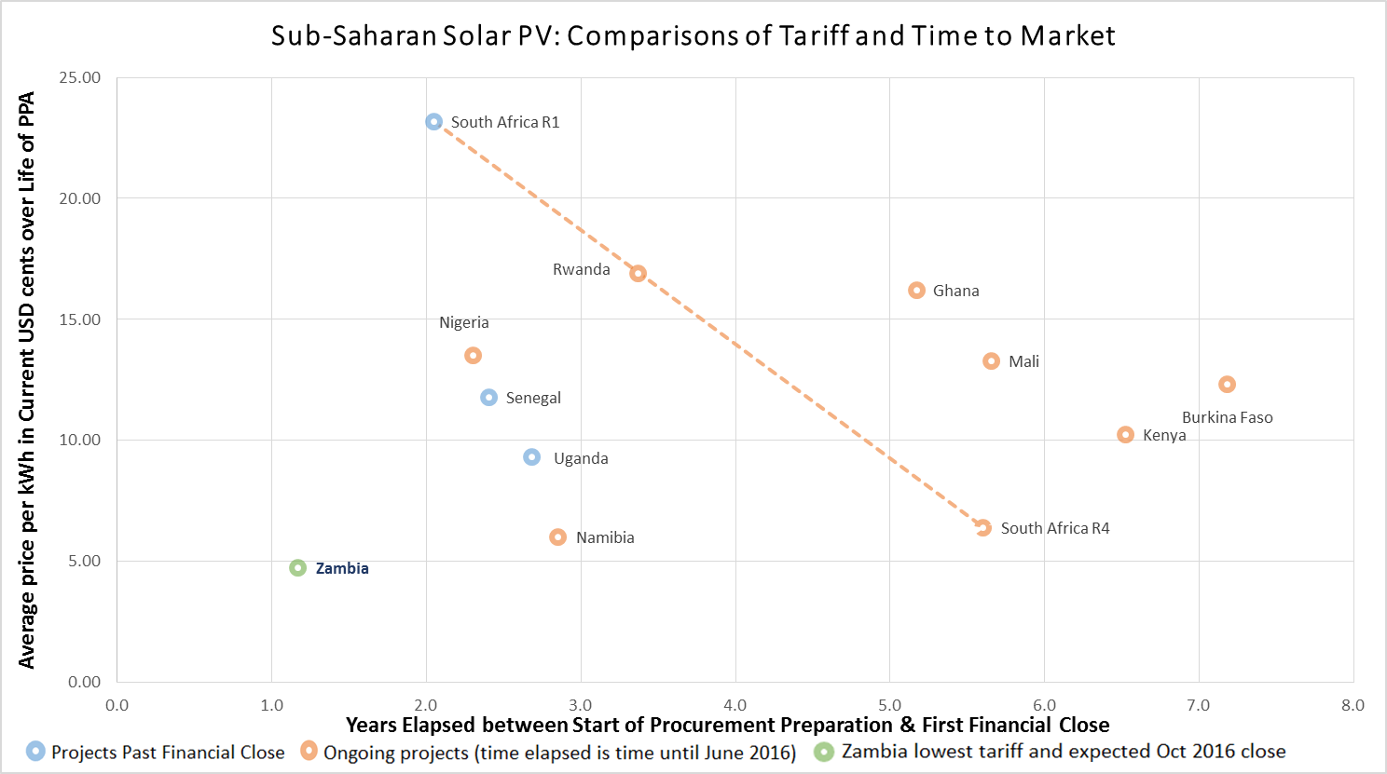
How Scaling Solar in Zambia stacks up relative to regional benchmarks

Slide 10
How will it work? Scaling Solar’s 5 steps
Several WBG instruments brought together under a single product offering
Client governments would engage in a single mandate to access the “one-stop-shop”
1
2
3
4
5
Project Preparation
Bid Preparation
Tender Process & Award
Financial Close
Construction
& Operation
Technical and economic analysis for optimal size and location of PV plants Site investigation Legal & regulatory analysis | Template tender documents Template project documents Attachment of stapled financing, insurance and credit enhancement | Request for qualification Bidder consultation Request for proposals Proposal review and award Signing of project documents | Finalization of equipment, construction and operation contracts Final project approvals Finalization of loan agreements, insurance and risk management | Construction Commissioning Operation
8 months
6 months
10 months

Slide 11
The tendering process: What are the “template documents”?
Engagement Letter & ToRs for specialized Consultants
Power Purchase Agreement & Government Support Agreement
Pre-Qualification Document & Request for Proposals
Letter of Interest and Indicative financing terms
Government signs a Letter of Engagement with IFC’s Advisory Services
A World Bank Group team is put in place
Specialized consultants are hired based on existing Terms of References
Documents designed as fair, balanced & bankable
Prepared by World Bank Group with support of Linklaters & Norton Rose independent review
Tendering documents are ready and have been designed to attract top tier developers and investors
Indicative terms for debt financing as well as terms for Partial Risk Guarantees are available and have been through preliminary internal approvals
Critical for this set of documents to be utilized in their template forms to achieve scaled, competitive solar power within 2 years

Slide 12
What are the benefits?
For Governments:
For Project Developers:
For Donors*:
Speed
Customized process
Certainty
Competitive fixed-rate tariffs
Market creation
Reduced development time
Level playing field
Regional scale
Reach
Leverage
Transparency
Impact
* Opportunities for donors include: funding transaction advisory (steps 1-3) or provision of capital grants to all bidders to lower tariffs and improve affordability

Slide 13
The World Bank Group is well-positioned to deliver
The World Bank Group has a long track record working across power sectors, key stakeholders and unique challenges. IDA and IBRD support client country governments with financing and advice to extend access to electricity, expand least-cost generation, create sustainable regulation and leverage the private sector.
IFC is experienced in developing bankable private power projects and has a substantial track record in both tendering and financing solar power plants. MIGA provides a range of political risk insurance products to attract private capital into emerging markets.
Regulatory reform
Project structuring
Project Development
Investment
Monitoring
Working to introduce sector reform and achieve sector sustainability
Strengthening utilities’ performance
Setting the conditions to attract private investment
Advising governments on PPPs
Negotiating key contracts
The $150m IFC InfraVentures fund helps cover essential early-stage costs of frontier market projects
IFC’s Advisory Services advise Governments in Project structuring and helps balanced deals to be struck
Financing projects through debt, equity and mobilization of resources from other sources
Obtaining concessional financing from multi-donor sources
Assessing projects’ consistency with IFC’s Performance Standards on environmental and social issues
Tracking projects’ results and sharing the lessons for wider replication and impact
Together, the World Bank Group is uniquely positioned to deliver the Scaling Solar solution.

Slide 14
World Bank Group research on tender design

Slide 15
Next Steps – Expressions of Interest
Receipt of an Expression of Interest from Government
Discussions to confirm and agree:
    Suitability of Scaling Solar in country context
    Sufficiency of stakeholder support (MoE, MoF, Utility, Regulator)
    Identification of a government champion to drive the project
    A timeline from mandate to selection of a Preferred Bidder
Signing of a mandate with the World Bank Group to:
    Conduct technical studies
    Run a competitive tendering process complete with standardized documents and stapled financing
Make initial payment for advisory services as per the engagement letter
WBG team to run due diligence process and, after consultation and agreement from Government, tendering process
Expected timeline from mandate to selection of Preferred Bidder: 6 to 12 months

Slide 16

Questions or Interest? Please contact us
  Webpage: www.scalingsolar.org
  Contact: scalingsolar@ifc.org

